Slide 1
Agenda
Give a small scenario
What is AppDynamics
Features and functions
AppDynamics at Pratt & Whitney
AppD Model
Licenses and monitoring
Dashboard
Process Based Approach
Next Steps
Notes:
Intro AppD
We run AppD in your environment
This is a view from your Pratt Environment
Top 5 things
Demonstration drill down

Slide 2

AppDynamics at
Pratt and Witney
January 2025
Notes:
Audience:
When to use:

Slide 3
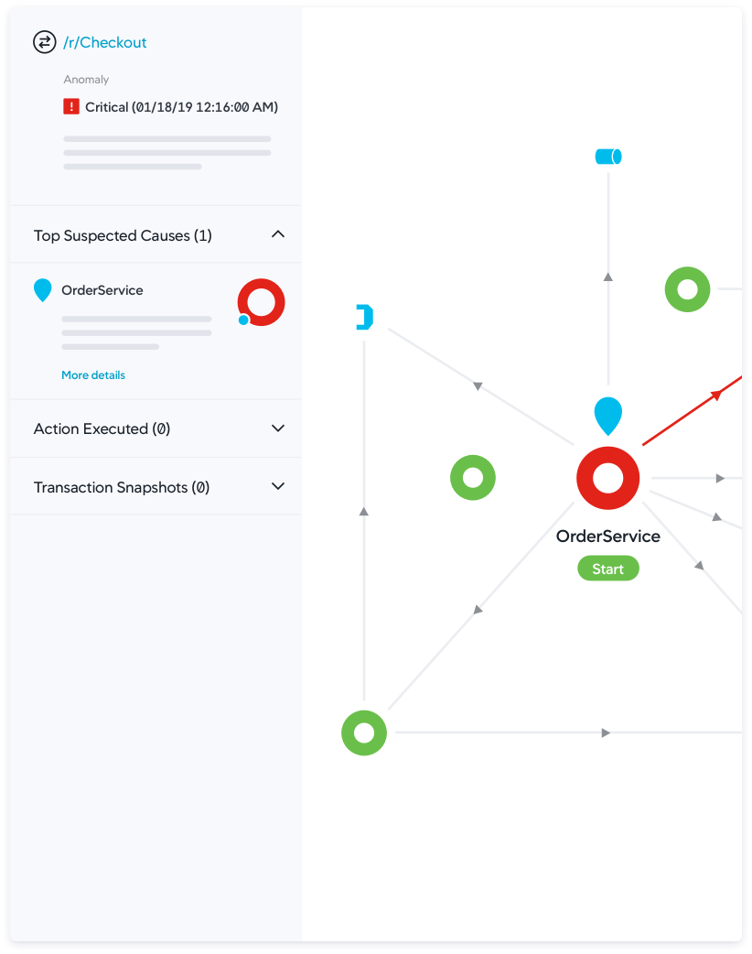
AppDynamics Features & Benefits
Data Collection:
AppDynamics Agents monitor your entire application ecosystem, collecting real-time performance data. The Controller visualizes this data and sends instructions to the agents.
Auto-Discovery & Mapping:
Automatically discovers traffic flow and creates dynamic topology maps to visualize performance across your application environment.
Digital Experience Monitoring:
Track user experiences with web, mobile, and synthetic monitoring to catch issues early. Monitor key metrics across devices, browsers, APIs, and services.
Business Transaction Monitoring:
Monitors critical user transactions like logins and checkouts, ensuring seamless performance for revenue-driving activities.
Anomaly Detection:
Automatically baseline performance and set alerts to detect and resolve issues before they impact users.
Root Cause Diagnostics:
Reduce mean time to resolution (MTTR) with actionable insights, allowing IT teams to prioritize and fix critical issues quickly.
Full-Stack Analytics:
Gain insights into key transaction data to drive better decisions and support digital transformation goals.
Custom Dashboards:
Easily create custom dashboards for full-stack visibility, now enhanced with ThousandEyes network intelligence.
Notes:
AppDynamics offers powerful application performance management features such as real-time performance monitoring, end-to-end transaction visibility, and code-level diagnostics. It uses AI-powered root cause analysis, dynamic baselines, and anomaly detection to quickly identify and resolve performance issues.
At Pratt & Witney we use OnPrem. AppD has the ability monitor multi-cloud and containers.
AppDynamics is an APM tool at first. But it has the ability to track user experience from out of the box or custom dashboards.
Optimizing performance across complex environments can be simple as a view from the flowmap.
The key benefits include faster issue resolution, enhanced user satisfaction, reduced downtime, and actionable insights that link application performance to business outcomes.
Helping organizations improve both operational and business efficiency.

Slide 4
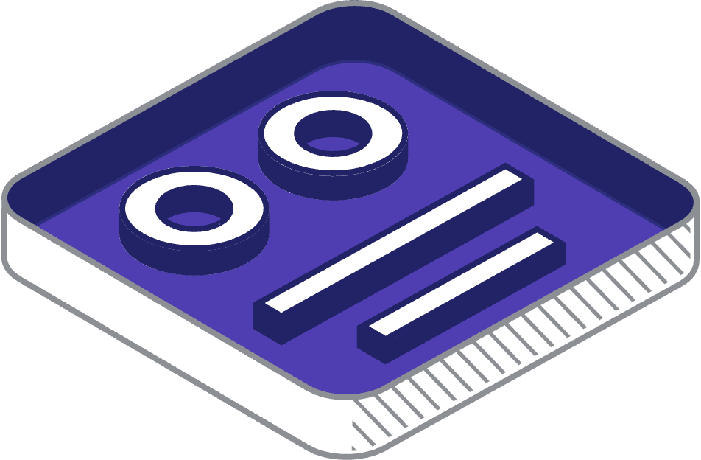
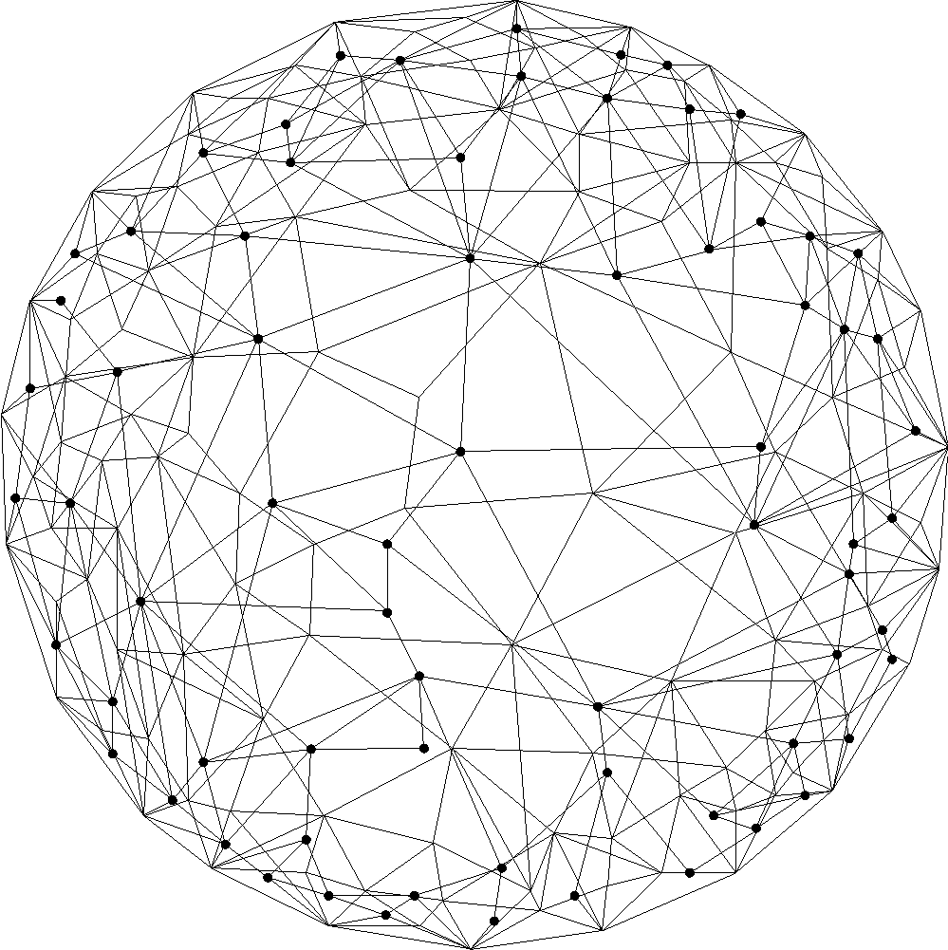
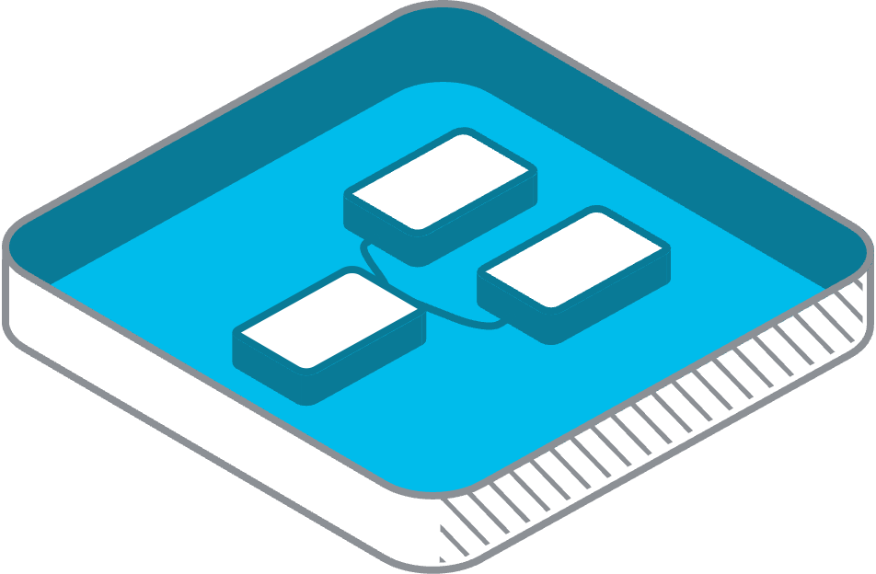






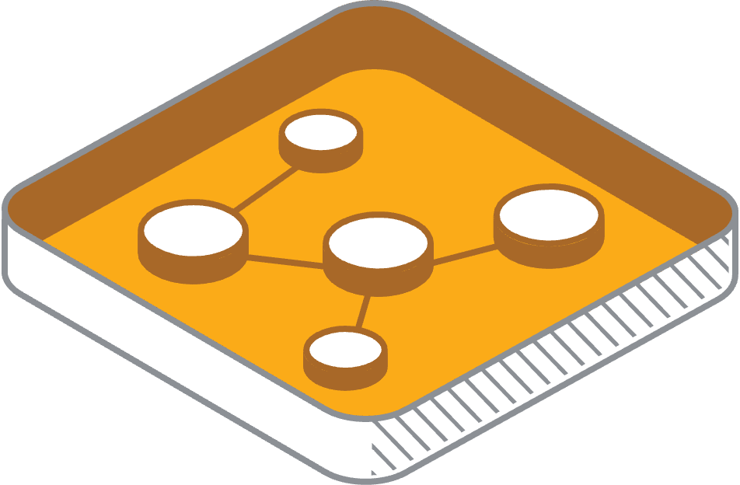
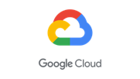
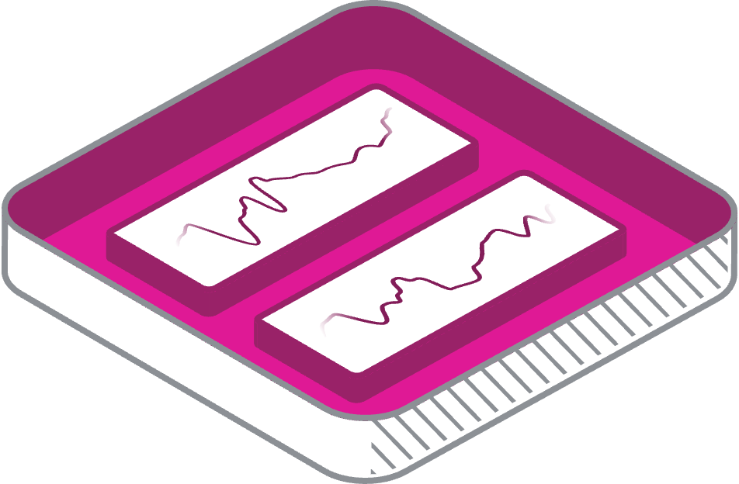




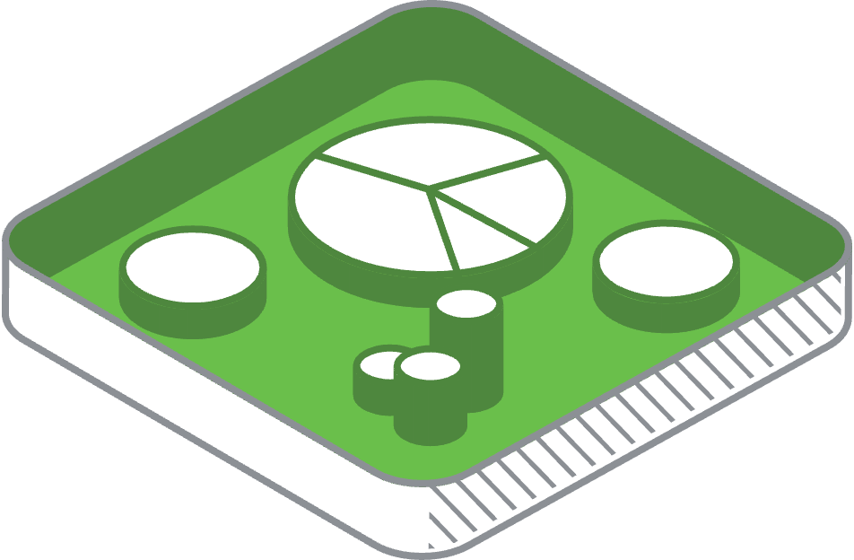




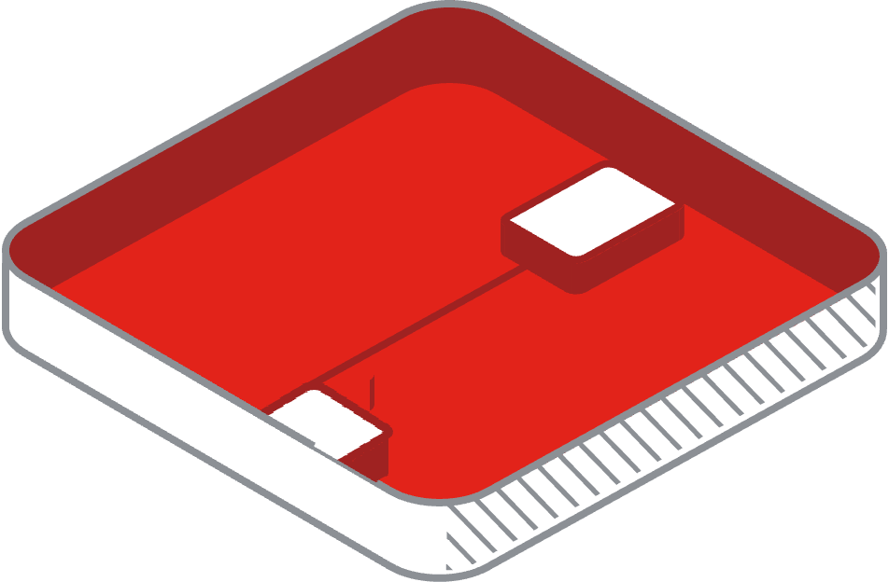
Use Case Full–Stack Visibility
SaaS
BUSINESS
USER EXPERIENCE
CLOUD PROVIDERS
SaaS
SERVICE PROVIDERS
APPLICATION
COLOCATION
SaaS
INFRASTRUCTURE
SaaS
SaaS
NETWORK
CAMPUS
BRANCH
DATA CENTER
EDGE | IOT & OT
SECURITY
Notes:
From Full-Stack
in AppDynamics bridge the gap between application performance and business outcomes.
You complete visibility into your entire application stack— The tool automatically generates a *Flow Map*. With this map, you can easily identify which components are affected by slow transactions or other issues.
The visual representation allows you to drill down to pinpoint the *root cause* of the problem. Whether it’s a database query taking too long, a third-party service that’s unresponsive, or a bottleneck in the code, you can identify and address the issue efficiently. Ensuring smooth and reliable application performance while reducing downtime.
From Business context
We can detect anomalies—marked here as red that indicate performance issues. These red flags help identify areas of concern that need immediate attention.
we extract meaningful context from this visibility. For example, a dashboard showing issues related to logging into the supplier portal. We can create custom metrics to help us identify specific key functions of the application. We can create custom metrics to help us simplify the performance of the user journey
Having that insight provides us a end-to-end approach: identifying issues, better business insights, data-driven actions to improve performance and outcomes.

Slide 5

Use Case Full Stack Observability
with Business context
Prioritize issues with Business Context
Full-Stack
Visibility
Full-Stack Insights
Application Business & Experiences
Full-Stack Actions
Remediations & Optimizations
Log in supplier portal
Revenue
Delivery information
App API Call
Remediations
Conversion
Capacity information
3rd Party SaaS service
Delivery Service
Routing Optimization
Delivery confirmation
User journey
Accounts Payable report
Cloud Instance
Scale Down
Full-Stack actions for the business
Notes:
Let’s talk about how *Full-Stack Observability* empowers businesses to bridge the gap between application performance and business outcomes.
---
Imagine a tool that gives you complete visibility into your entire application stack—this is where Full-Stack Observability begins. By automatically generating a *Flow Map*, it provides a comprehensive view of your application’s performance. With this map, you can easily identify which components are affected by slow transactions or other issues.
This visual representation allows you to drill down to pinpoint the *root cause* of the problem. Whether it’s a database query taking too long, a third-party service that’s unresponsive, or a bottleneck in the code, you can identify and address the issue efficiently. This is a game-changer for ensuring smooth and reliable application performance while reducing downtime.
---
Now let’s take it a step further by connecting technical performance to *business context*—this is the real power of Full-Stack Observability.
- We start with *Full-Stack Visibility*: This layer continuously monitors the entire application ecosystem. As shown in the visual, we can detect anomalies—marked here as red dots—that indicate performance issues. These red flags guide us to areas of concern that need immediate attention.
- Moving to *Full-Stack Insights, we extract meaningful context from this visibility. For example, if there’s an issue with logging into the supplier portal or confirming a delivery, we link this back to its potential business impact. These insights highlight how technical issues can affect business-critical metrics like **revenue, **conversion rates, and the **user journey*.
- Finally, we take *Full-Stack Actions* to address these issues. This could involve API call remediations, optimizing delivery routes, or scaling cloud resources. By prioritizing these actions, we ensure that the most critical problems are resolved first, minimizing business disruption and optimizing costs.
---
In essence, Full-Stack Observability provides an end-to-end approach: identifying issues, contextualizing them with business insights, and enabling data-driven actions to improve performance and outcomes. It’s not just about fixing what’s broken—it’s about ensuring your technology serves your business goals seamlessly and efficiently.

Slide 6
Use Case Full Stack Observability
with Business context
Prioritize issues with Business Context
Full-Stack
Visibility
Full-Stack Insights
Application Business & Experiences
Full-Stack Actions
Remediations & Optimizations
Log in supplier portal
Revenue
Delivery information
App API Call
Remediations
Conversion
Capacity information
3rd Party SaaS service
Delivery Service
Routing Optimization
Delivery confirmation
User journey
Accounts Payable report
Cloud Instance
Scale Down
Full-Stack actions for the business
Notes:
Full-Stack Observability empowers businesses to bridge the gap between application performance and business outcomes.
AppDynamics gives you complete visibility into your entire application stack. Once instrumented AppD automatically generates a *Flow Map*, providing a holistic view of your application’s performance. With this map, you can easily identify which components are affected by color code or timeframe.
This visual representation allows you to drill down to pinpoint the *root cause* of the problem. Whether it’s a database query taking too long, a third-party service that’s unresponsive, or a bottleneck in the code, you can identify and address the issue efficiently. This is a game-changer for ensuring smooth and reliable application performance while reducing downtime.
Let’s take it a step further by connecting technical performance to *business context*—this is the real power of Full-Stack Observability.
- We start with *Full-Stack Visibility*: This layer continuously monitors the entire application ecosystem. As shown in the visual, we can detect anomalies—marked here as red dots—that indicate performance issues. These red flags guide us to areas of concern that need immediate attention.
- Moving to *Full-Stack Insights, we extract meaningful context from this visibility. For example, if there’s an issue with logging into the supplier portal or confirming a delivery, we link this back to its potential business impact. These insights highlight how technical issues can affect business-critical metrics like **revenue, **conversion rates, and the **user journey*.
- Finally, we take *Full-Stack Actions* to address these issues. This could involve API call remediations, optimizing delivery routes, or scaling cloud resources. By prioritizing these actions, we ensure that the most critical problems are resolved first, minimizing business disruption and optimizing costs.
In essence, Full-Stack Observability provides an end-to-end approach: identifying issues, contextualizing them with business insights, and enabling data-driven actions to improve performance and outcomes. It’s not just about fixing what’s broken—it’s about ensuring your technology serves your business goals seamlessly and efficiently.

Slide 7
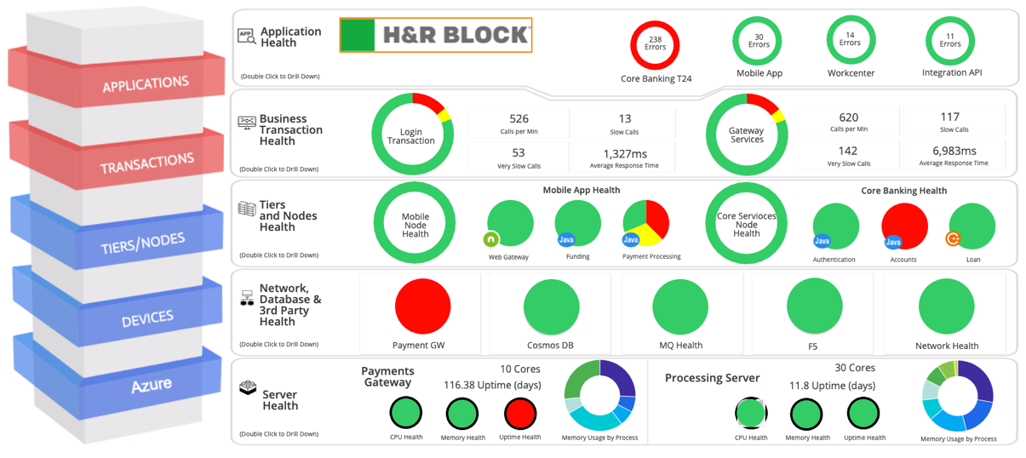

AppDynamics Sample Dashboard
Postal Services
Art of Possible Application and Infrastructure Dashboard:
Dashboard can represent any Application’s Environment
Top to Bottom Application Infrastructure View
Customize based upon customer requirements
Notes:
A custom dashboard enables you to display a specific set of metrics and data points on one screen. All customizable but we want to standardize it, one for business and another for technical folks.
Business
We can assign a dashboard for an executive who may only need a high-level view of system performance and activity.
Developer
Dashboard to view server and database metrics. Number of Call Load per node. Slow Calls per Node. Memory usage, Number of of Error Rate

Slide 8
AppDynamics at Pratt and Whitney

Slide 9
AppDynamics at Pratt and Whitney
Deployed across Quality and production environment across Pratt & Whitney US and Canada
Monitoring business critical application with Pratt & Whitney such as
Solumina
Team Center
Tidal
Kepware
Autoair
Monitoring across Application, infrastructure, Database, network and End user monitoring
Some of primary use-cases are –
Slow Transaction detection
Slow responses on several critical queries
Proactively notification to the teams.
Trace level information and debugging information
Notes:
We chose AppDynamics because of its superiority in security and low overhead on its system. And most importantly it offers OnPrem solution.
We have controllers in production and lower environment. Both in US and Canada.
Some of the applications we monitor are Solumina, Team Center, Tidal, Kepware, and Autoair.
We have comprehensive visibility into application performance, infrastructure, databases, networks, and EUM is a new addition. Gaining insights to end-user experience in one .
Key use cases include detecting slow transactions, identifying sluggish query responses, and proactively notifying teams. AppDynamics also delivers trace-level insights and debugging information to help maintain optimal performance and quickly resolve issues.

Slide 10
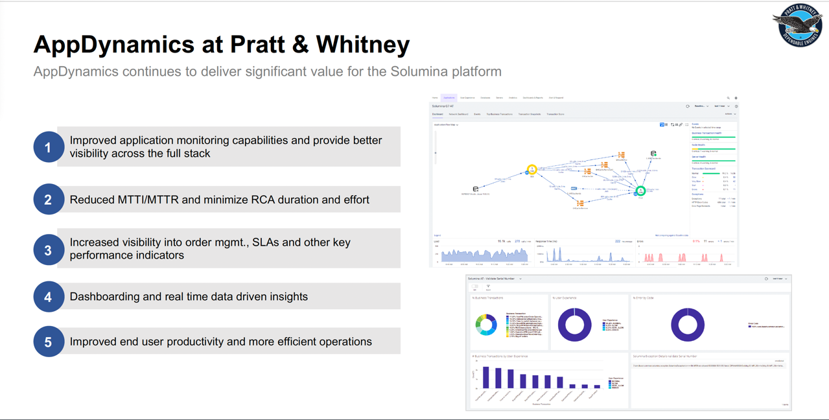
Notes:
Some of the achievements we made with the Solumina platform.
Improving full-stack application monitoring, reduce Mean Time to Identify/Resolve, and minimizing Root Cause Analysis (RCA) effort.
Visibility into order management, SLAs, and key performance metrics while providing real-time, data-driven insights through dashboards. These capabilities drive improved end-user productivity and operational efficiency.

Slide 11
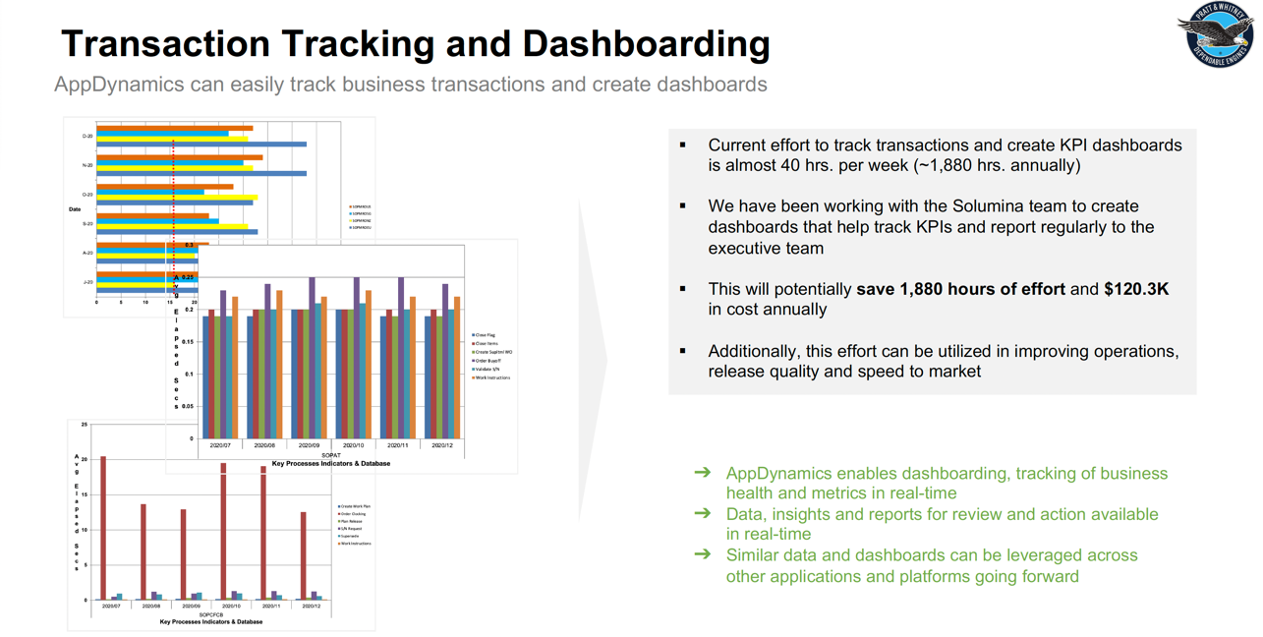
Notes:
Streamlining transaction tracking and KPI dashboard creation saved Pratt and Whitney approximately 1,880 hours and $120.3K annually.
We automated these processes using AppDynamics. This provided real-time insights and operational efficiency.
The dashboards helped track business metrics, aiding the executive team in decision-making and supporting similar initiatives across other platforms.

Slide 12
AppDynamics Kyndryl Team
Q&A
Damian Waid
Service Delivery Manager
Staci Steger
Team Lead/Project Manager
Sayed Rahman
AppDynamics Engineer
Raj Patel
AppDynamics Engineer
John Wannemacher
AppDynamics Engineer
Adam Featherston
AppDynamics Engineer

